Slide 1
Employee Management System
Presented by Group-2 :
Anusha.K P
Muthanna.N E
Nandini.S
Nowshad.S K
Tejas.M K
Varshini.R
Date:30/12/2021 Yashu Bopanna P D
1

Slide 2
CONTENTS
Introduction
CRUD Operation
Project Model
Snapshots
Tools Used
Future Scope
Conclusion
2

Slide 3
INTRODUCTION
Employee Management System
Employee Management System is a distributed application, developed to maintain the details of employees working in any organization.
Why EMS?
Overcome the problems of manual system.
Simplifies the task.
Reports to management of company.
3

Slide 4
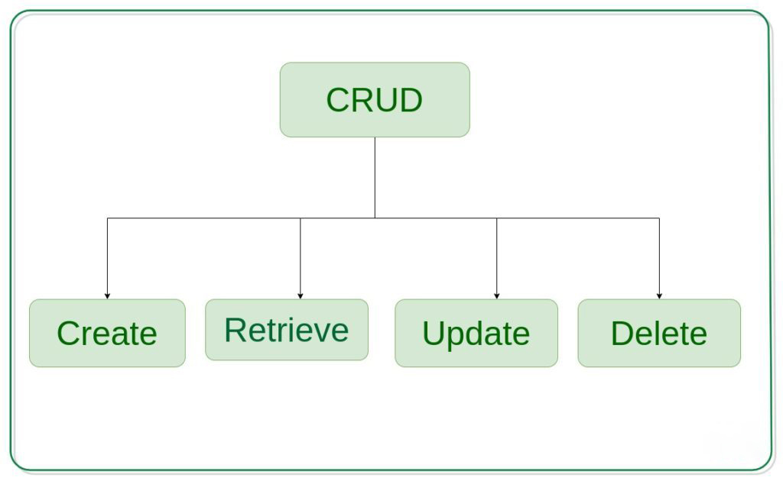
CRUD Operation

Slide 5
Within computer programming, the acronym CRUD stands for create, read, update and delete. These are the four basic functions of persistent storage.
CREATE procedures: Performs the INSERT statement to create a new record.
READ procedures: Reads the table records based on the primary keynoted within the input parameter.
UPDATE procedures: Executes an UPDATE statement on the table based on the specified primary key for a record within the WHERE clause of the statement.
DELETE procedures: Deletes a specified row in the WHERE clause.

Slide 6
Project Model
Welcome
Admin
Dashboard
All Employee
New Employee
Edit Employee
Remove
Database
Database
Database
Database

Slide 7
Modules
Our project have home page and it contains mainly two modules admin and dashboard view.
Admin can login providing login credentials.
Dashboard has 4 submodules :
All employee
New employee
Edit employee
Remove

Slide 8
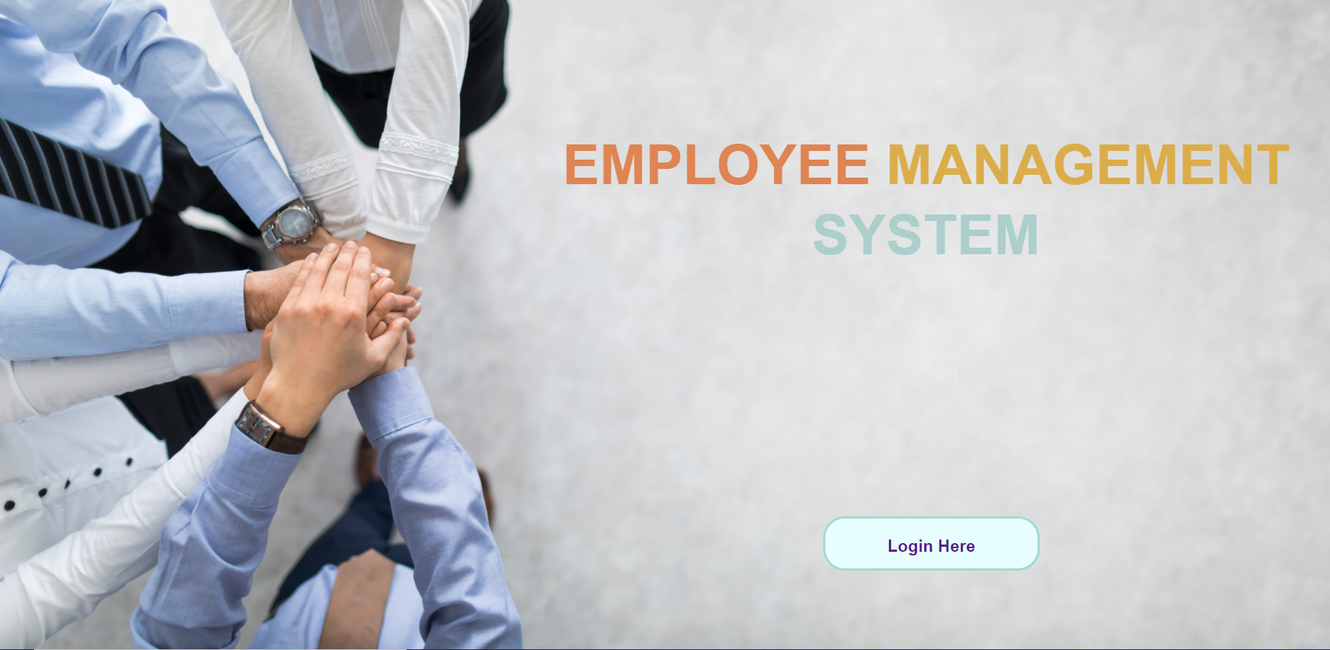
Home page

Slide 9
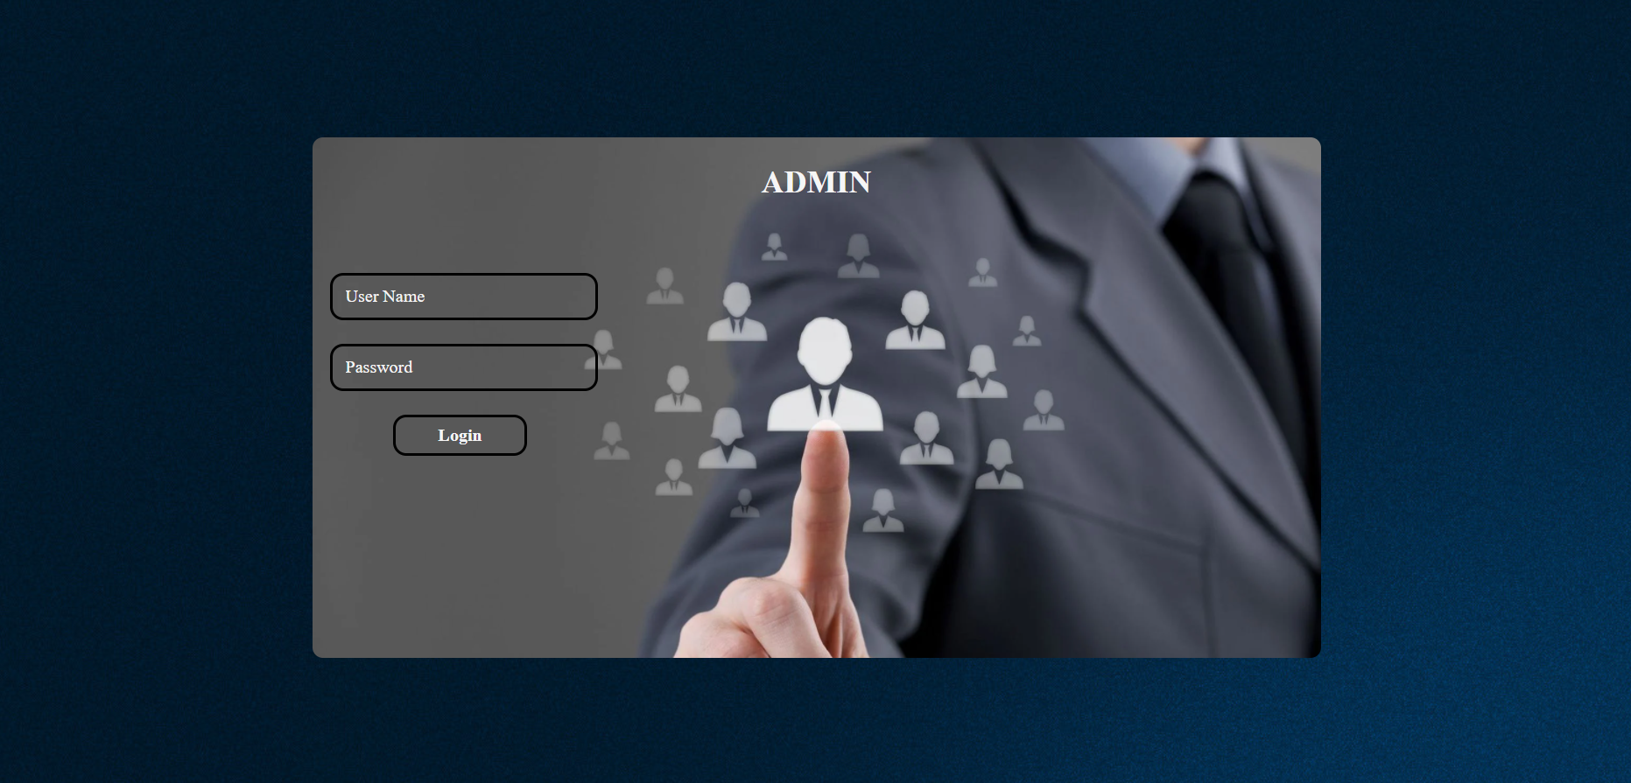
Login page

Slide 10
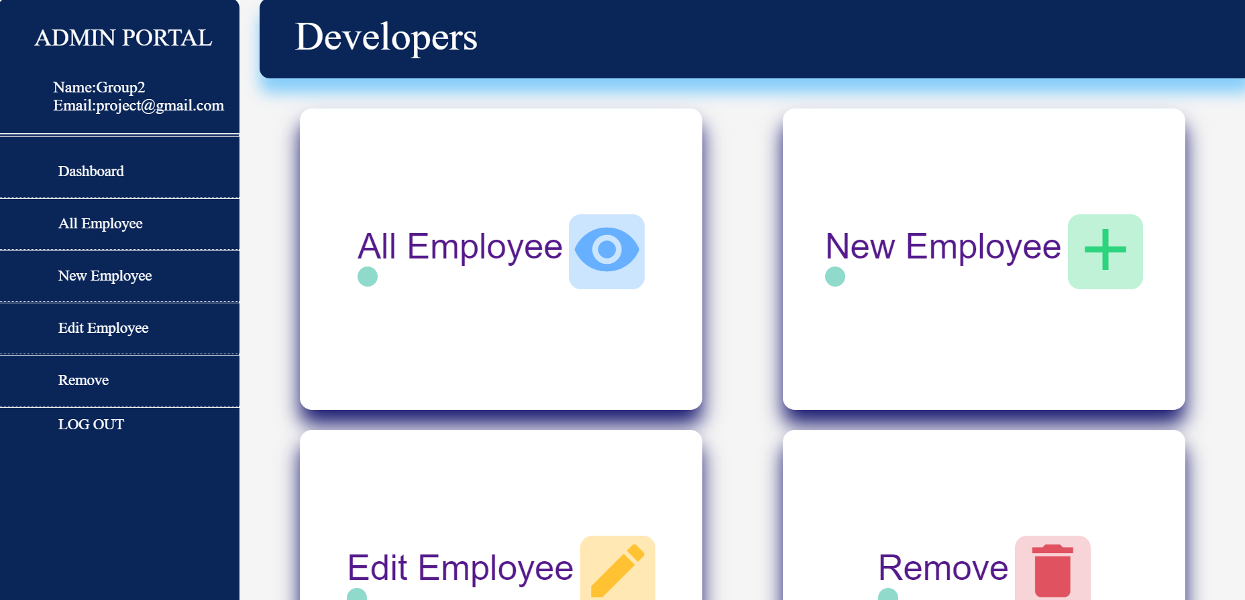
Dashboard

Slide 11
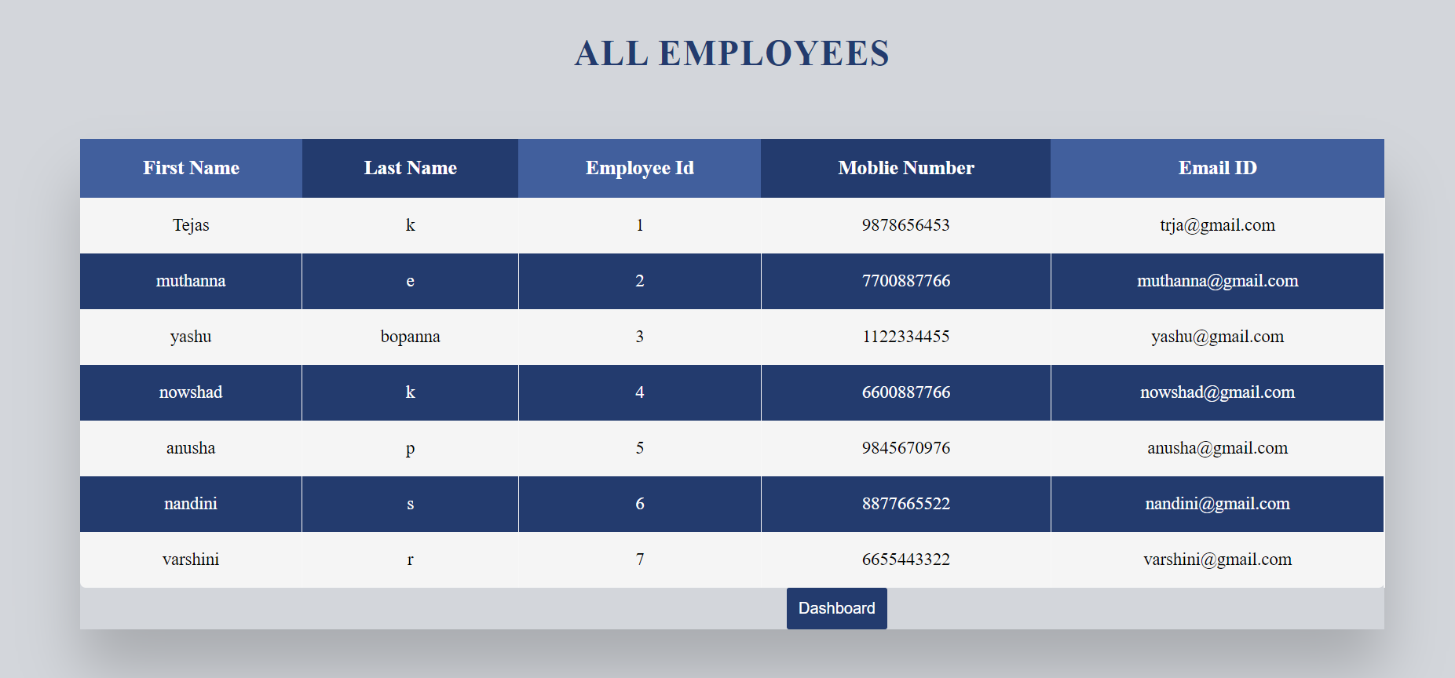
View employee

Slide 12
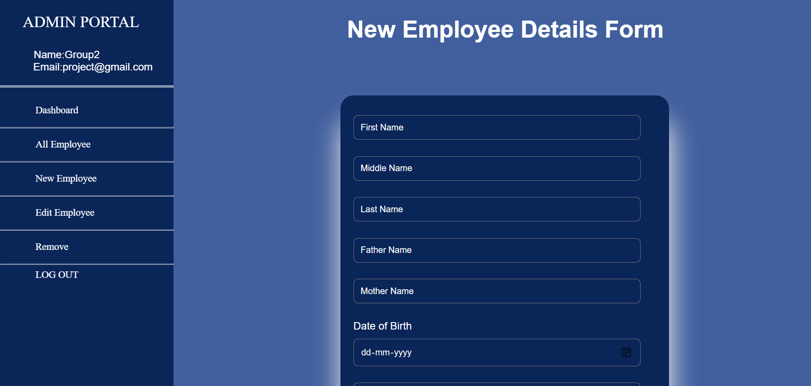
Add employee

Slide 13
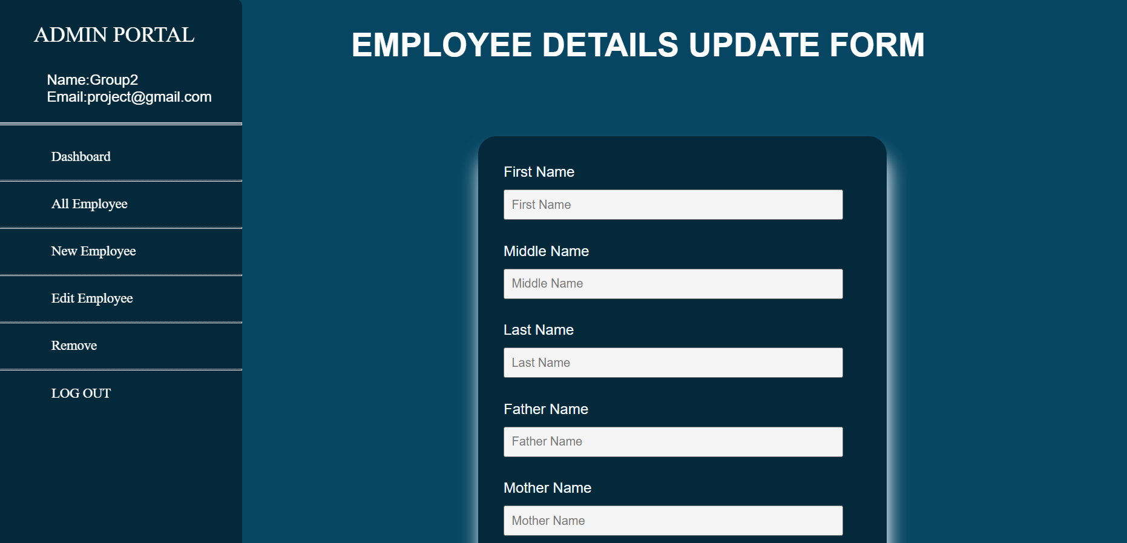
Update employee

Slide 14
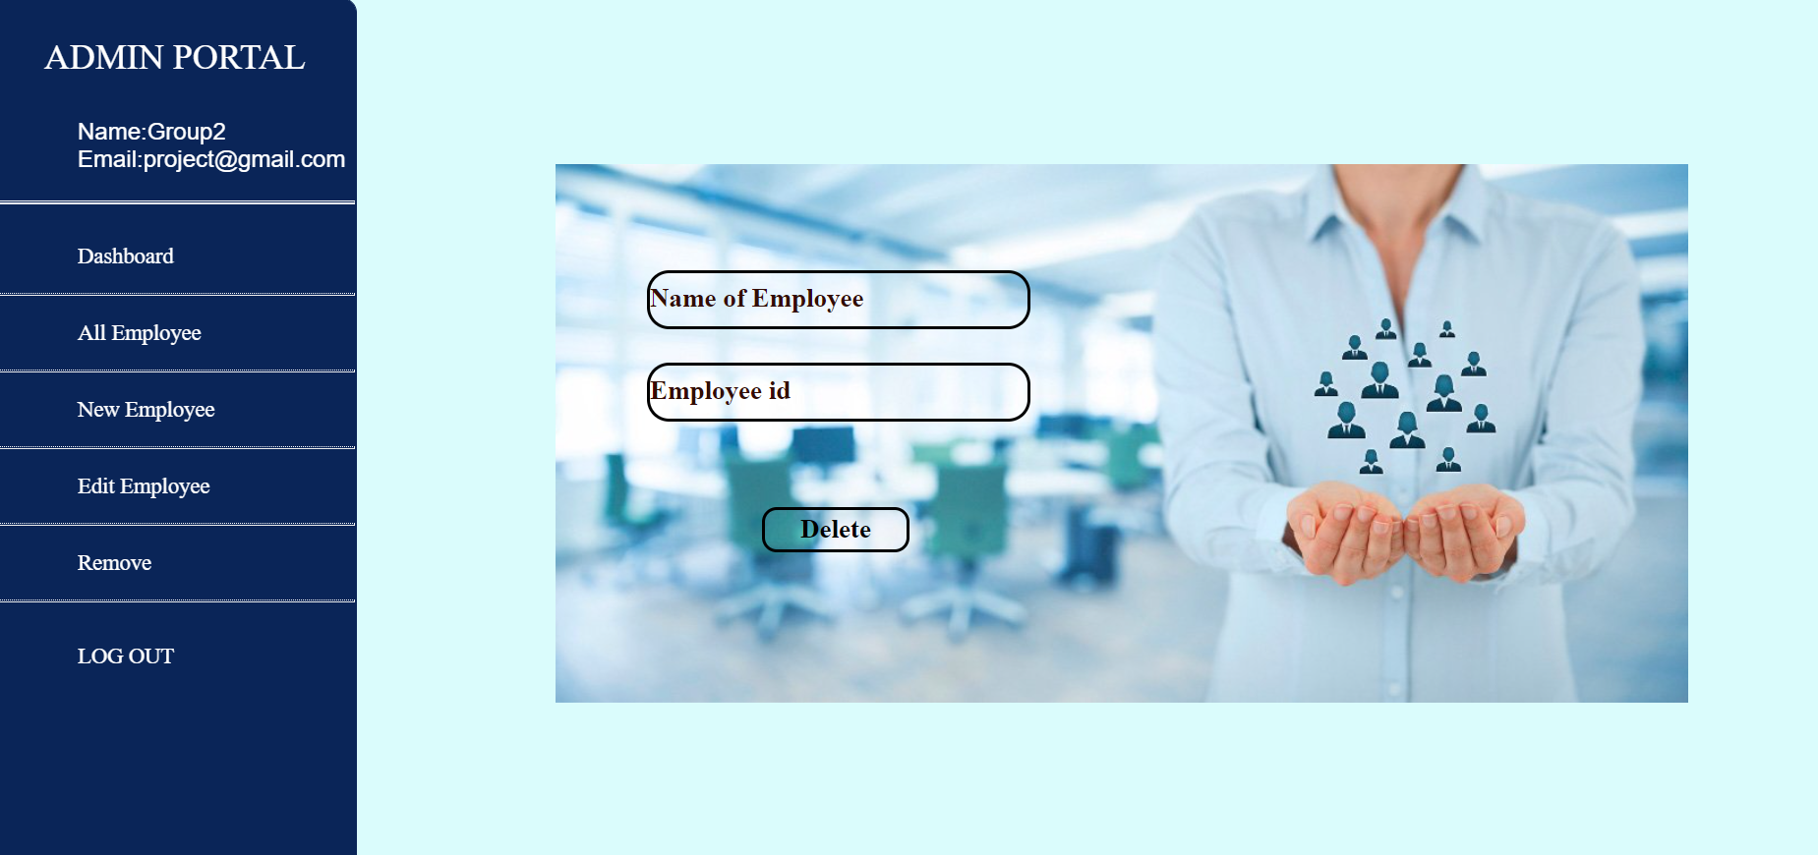
Delete employee

Slide 15

Tools Used
Angular
Angular is an open-source, JavaScript framework written in TypeScript .
Its primary purpose is to develop web applications.
It enables users to create large applications in a maintainable manner.
Version : 13.0.3

Slide 16

Tools Used
Spring Boot
Spring Boot is an open-source Java-based framework used to create a micro- Service.
Version : 4.13.0.RELEASE

Slide 17

Tools Used
Xampp
XAMPP is an acronym for Apache, MySQL, PHP, Pearl.
It is a free and open-source cross-platform web server solution stack package developed by Apache Friends, consisting mainly of the Apache HTTP Server, MariaDB database, and interpreters for scripts written in the PHP and Perl programming languages.

Slide 18
Future Scope
Maintain Details about payroll .
Manage leaves and Check leave status .
Check the Statistics ( progress in the work) .

Slide 19
CONCLUSION
The project is totally built at administrative end and thus only the administrator is guaranteed the access.
Admin manages all the information about Employee, Add new employee details, Edit Employee details, Remove Employee Details.
Enhancement to the project can easily be made without changing the current design and programming structure.

Slide 20
Thank You

